Slide 1

Shope Store

Slide 2
Key Objects
Ship Mode: Standard Class is the most common.
Customer Segment: Consumers dominate.
Category: Office Supplies is the top-selling category.
Sub-Category: Binders and Papers are the most popular sub-categories.
Region and State: California and New York are the top-performing regions and states.
City: New York City and Los Angeles lead in sales.
Product: The Canon imageCLASS 2200 Advanced Copier is the top-selling product.

Slide 3

Objective
"The objective of this analysis is to identify the top-selling product categories and regions in order to increase sales by 10% within the next quarter."

Slide 4
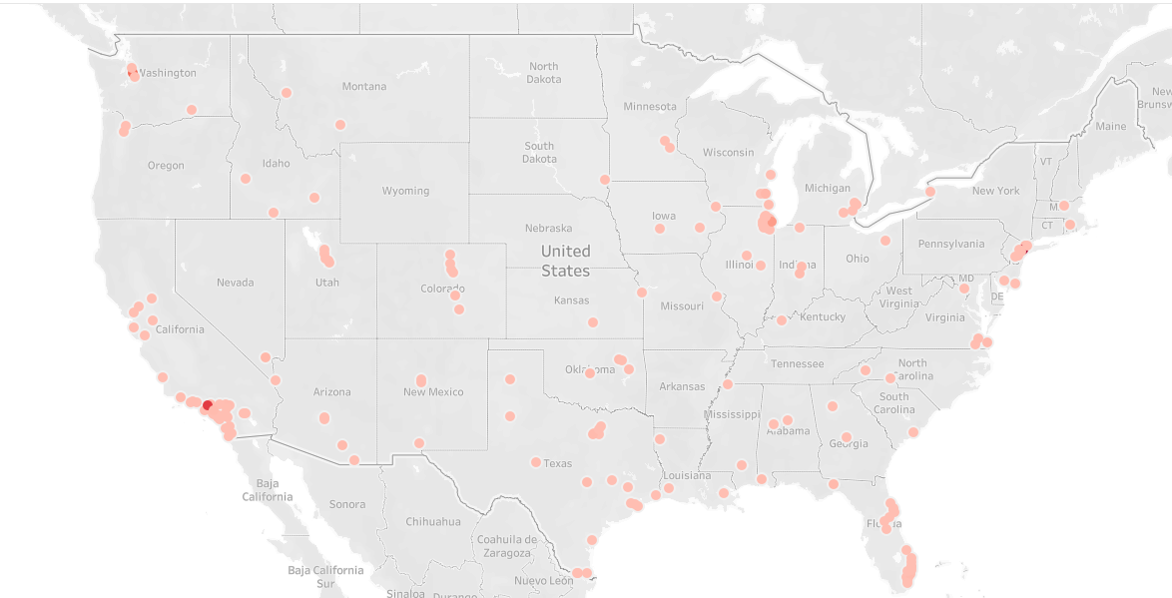
Presenting the Data

Slide 5
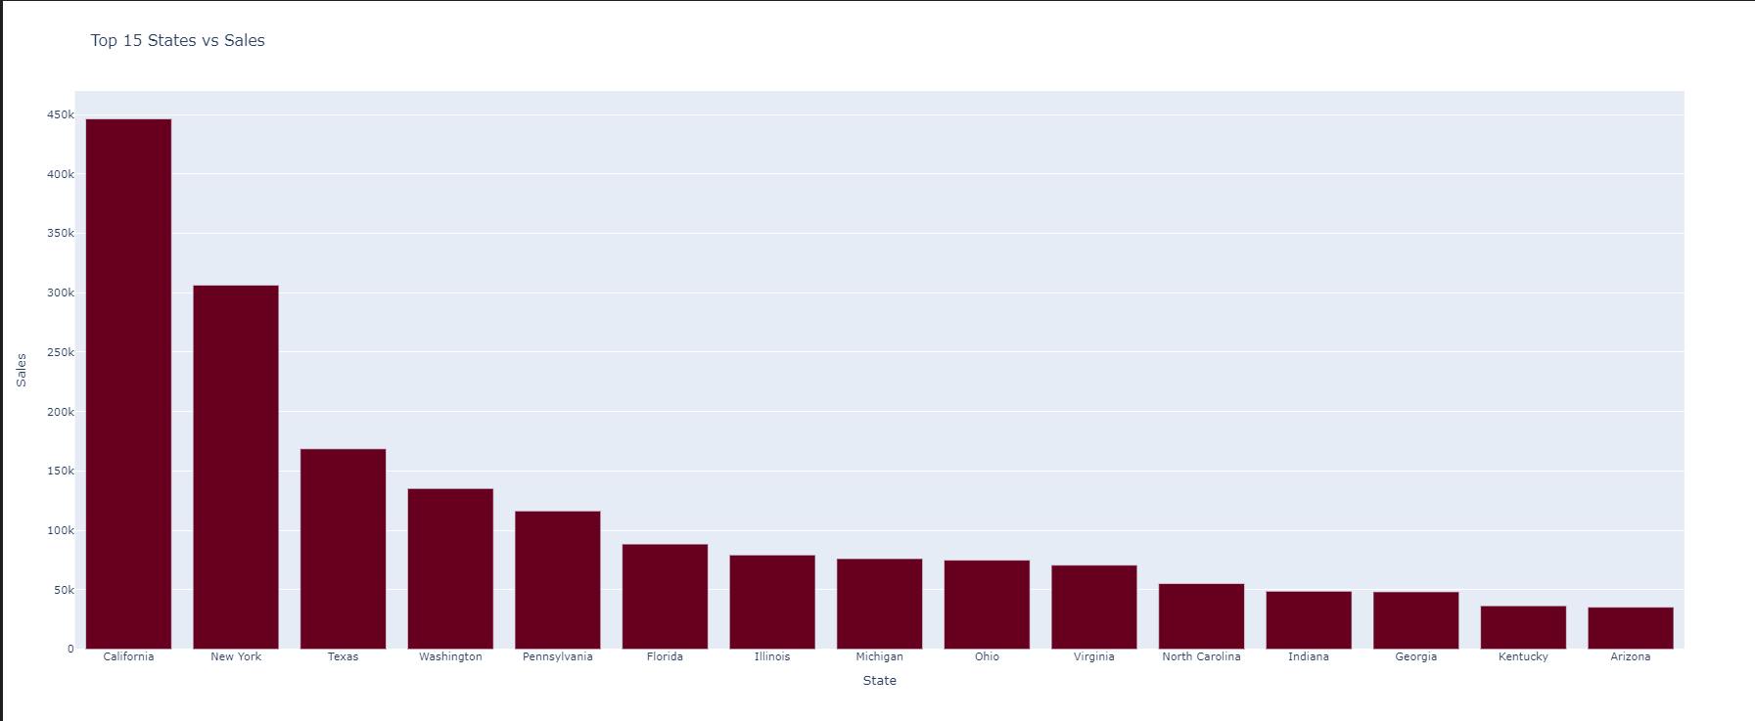
Most of the Sales are from California and New York States
If we find that sales in a Midwestern state are lower due to a lack of brand awareness, we could focus on increasing our marketing efforts in that region through local TV commercials, radio ads, and targeted digital campaigns. Additionally, partnering with local influencers or community organizations could help build brand recognition and credibility.
By implementing these strategies and continuously monitoring our performance, we can increase sales in underperforming regions and achieve your 10% goal.

Slide 6
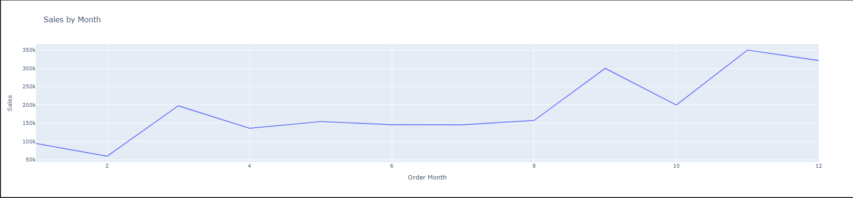
Analyzing the Sales by Month
The chart shows a clear trend of increasing sales from Month 1 to Month 11, followed by a slight decrease in Month 12. This pattern suggests that there might be seasonal factors influencing sales.

Slide 7

Reasons for Lower Sales in Month 2:
Seasonality: Certain industries or products might experience a seasonal decline in demand during this month. For example, if your business sells winter clothing or holiday decorations, sales might naturally decrease in February.
Economic Factors: Economic fluctuations, such as tax season or changes in interest rates, could affect consumer spending.
Competitor Activities: Increased promotions or new product launches by competitors might divert customer attention.
Internal Factors: Issues such as supply chain disruptions, inventory shortages, or marketing campaigns that didn't resonate with customers could also impact sales.

Slide 8
Strategies to Increase Sales:
Seasonal Promotions: Offer seasonal discounts or promotions to attract customers and stimulate demand.
Product Bundling: Create product bundles or cross-selling opportunities to increase average order value.
Customer Loyalty Programs: Reward repeat customers with loyalty discounts or exclusive offers. .
Customer Feedback: Gather customer feedback to identify areas for improvement and address any concerns.

Slide 9
Specific Strategies for Month 2:
Valentine's Day: If applicable, create a special campaign or product line to capitalize on the Valentine's Day holiday.
Seasonal Discounts: Offer discounts on products that are relevant to the season or upcoming events.
Limited-Time Offers: Create a sense of urgency with limited-time promotions or flash sales.

Slide 10
Why do seniors not receive news about products that are released to the market?
1. Personal visits: Organizing visits to homes or places where they gather, such as clubs or care centers.
2. Community events: Participating in local events or organizing workshops, where products can be displayed directly and people can interact.
3. Advertising in local newspapers: Publishing advertisements in newspapers that seniors read.
4. Family communication: Encouraging family members to talk to seniors about products and their features.

Slide 11
Thanks

